Slide 1

Team Details
Team Name: TRAILBLAZERS
Team Leader Name: SUDHEEKSHA S
Problem Statement: Turning Agri-waste into Profitable Business Opportunities

Slide 2
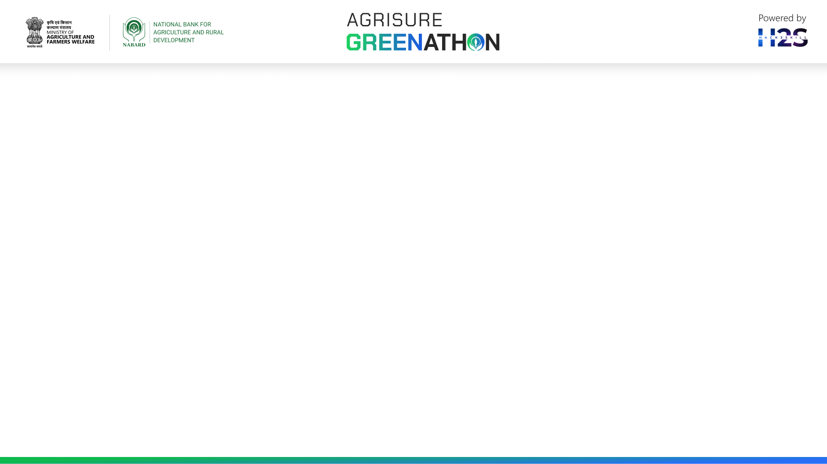
IDEA BRIEF
At the end of the fiscal year 2020, India possessed approximately 44 million hectares of land dedicated to rice cultivation, 29.8 million hectares for wheat, and 9.98 million hectares for corn.
Annually, India yields 120 million tons of rice, 112.18 million tons of wheat, 33.5 million tons of corn, and 2 million metric tons of ragi.
On an average 500 Mt of crop residue is generated yearly in India. While a majority of it is used for fodder still there is a huge surplus of 220 Mt out of which 132 Mt is burnt each year, mainly in the northern states such as Punjab, Haryana and Uttar Pradesh
Due to the absence of adequate sustainable management practices, roughly 53% of this paddy crop's solid waste, 37% of wheat crop residues, Maize, the crop that is the third largest contributor to emissions, emitted 91 % of its total 2020 emissions due to the burning of Summer season residues, is burned each year, leading to excessive particulate matter emissions and air pollution.
India produces more than 400 million tonnes (MT) of agricultural waste every year.

Slide 3
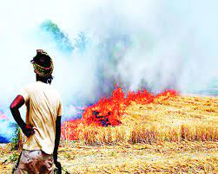
IDEA BRIEF
81% of straws and agri-residues are burnt in open field in India
Around 7300 kg CO2-eq/ha year-1 GHGs along with pollutants emitted due to straw burning
Straws are poor livestock feed, and rice straw is no exception. Paddy straw also contains Oxalates (2-2.5%) which leads to calcium deficiency so mineral mixture should always be fed along with the straw
The report says that Nearly 53% of rice straw is used for animal feed in India, Whereas the remaining 47% of straws are kept burn
This results in a substantial loss of heat and contributes to air pollution.
The best method to overcome the problem on managing the agri residues especially straws, is to convert the wastage or burning straws into AgriHeatblocks which replaces coal and firewood

Slide 4
IDEA BRIEF
Reason for choosing the paddy straws, paddy husks, corn cob and wheat straws is due to their calorific value which is greater than 4060 kcal/kg
This research uses conventional experimental method and based on the results, sample 1 produces maximum temperature of 335.4 degree C with a burning of 19.18 minutes and the calorific value of the proposed briquettes ranges from 15-17.3 MJ/kg.
S.No | Sample Description | Unit | Values
1 | Carbon | % | 33.60
2 | Hydrogen | % | 4.86
3 | Oxygen | % | 31.2
4 | Nitrogen | % | 0.31
5 | Sulphur | % | 0.025
CHONS VALUE OF AGRIHEATblocks

Slide 5
OPPURTUNITIES
Aspect | Existing Solution | AgriHeatblock
Traditional Burning | Causes air pollution and biomass loss as most agricultural waste is burned in open fields. | Efficient Use of Waste: Converts a wide range of agricultural residues into high-calorific value fuel blocks.
Composting | Useful but doesn't fully harness the energy potential of agricultural waste | Sustainability: Offers a sustainable alternative to burning waste.
Energy Production | Some biomass is used for energy, but the methods are often inefficient and not widespread. | Higher Efficiency: Demonstrates a higher calorific value and lower emissions compared to traditional methods.
Environmental Impact | Often leads to significant pollution and inefficient resource use. | Economic Viability: Provides farmers with a new revenue stream, making it economically appealing
Overall Effectiveness | Limited by inefficiencies and inability to fully utilize the potential of agricultural waste. | Combined Benefits: Environmentally and economically appealing solution for waste management and energy production.

Slide 6
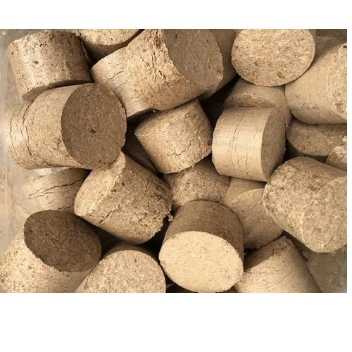
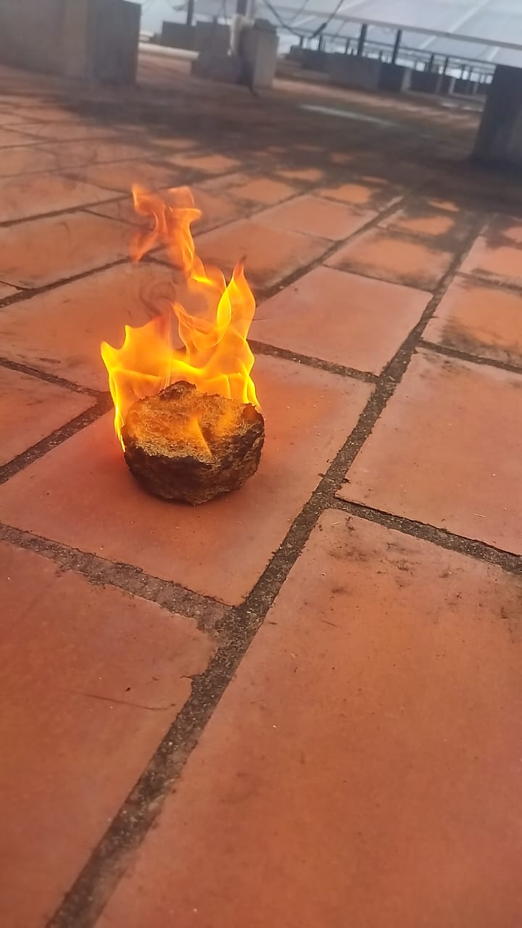
OPPURTUNITIES
SOLVES THE PROBLEM BY :
Reduction in Air Pollution: By converting waste into AgriHeatblocks instead of burning it, particulate emissions and air pollution are significantly reduced.
• Efficient Waste Management: Provides a sustainable method to handle agricultural residues.
• Energy Production: The high calorific value of the blocks makes them a viable alternative to fossil fuels for cooking and heating.
• Economic Benefits: Farmers can sell their waste rather than burning it, creating a new income source.

Slide 7
OPPURTUNITIES
USP of AgriHeatblocks
High Calorific Value: AgriHeatblocks have a calorific value exceeding 4050 kcal/kg, making them more efficient than other biomass solutions.
Low Ash Content: Produces less residue after burning, reducing maintenance and improving efficiency.
Environmentally Friendly: Significantly reduces air pollution and particulate emissions compared to open-field burning.
Economic Advantage: Provides farmers with a profitable use for their agricultural waste, turning a disposal problem into a revenue opportunity.
Versatile Usage: Suitable for various applications including cooking and heating, making it a flexible energy source.

Slide 8
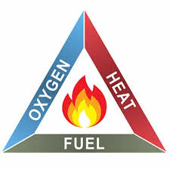
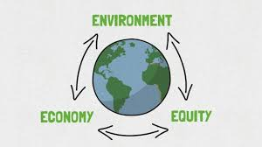
Features offered by AgriHeatblocks
• High Calorific Value
• Low Ash Content
• Sustainability
• Economic Viability
• Environmental Benefits
• Versatility
• Efficient Combustion
• Renewable Resource
• Energy Efficiency
• Health Benefits

Slide 9
Making Process flow
Agri Residues Collection from farmers
Moisture Removal using Drying Process
Reduction of Size by chopping
Grinding of Residues
Binder Preparation with corn starch
Densification
Binder addition and Ratio Mixing
Pressing
Compaction
AgriHeatblocks

Slide 10
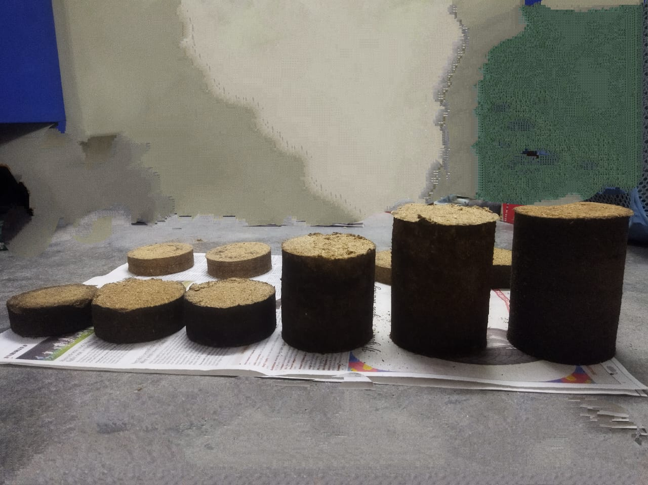
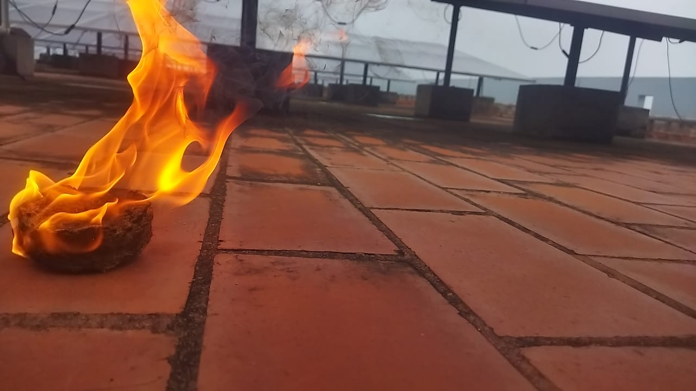
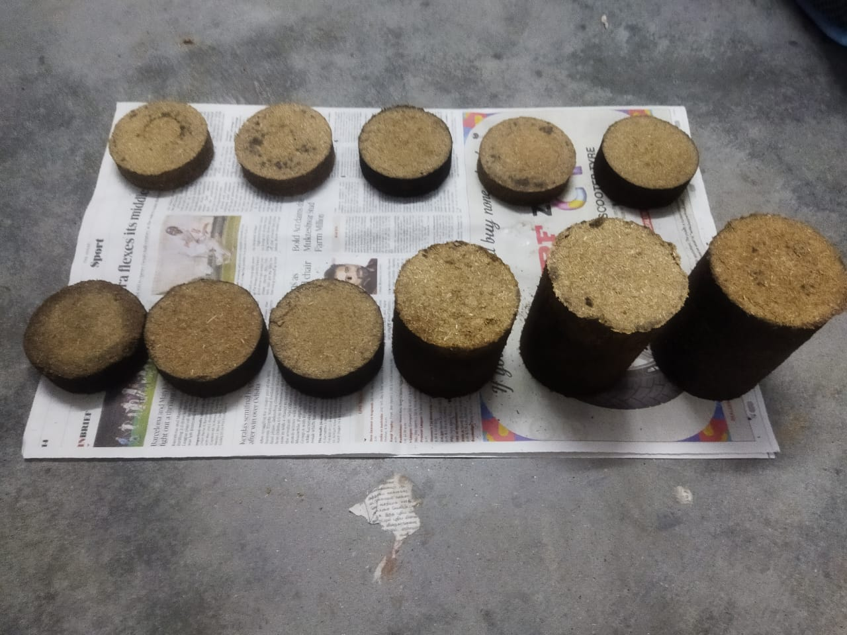
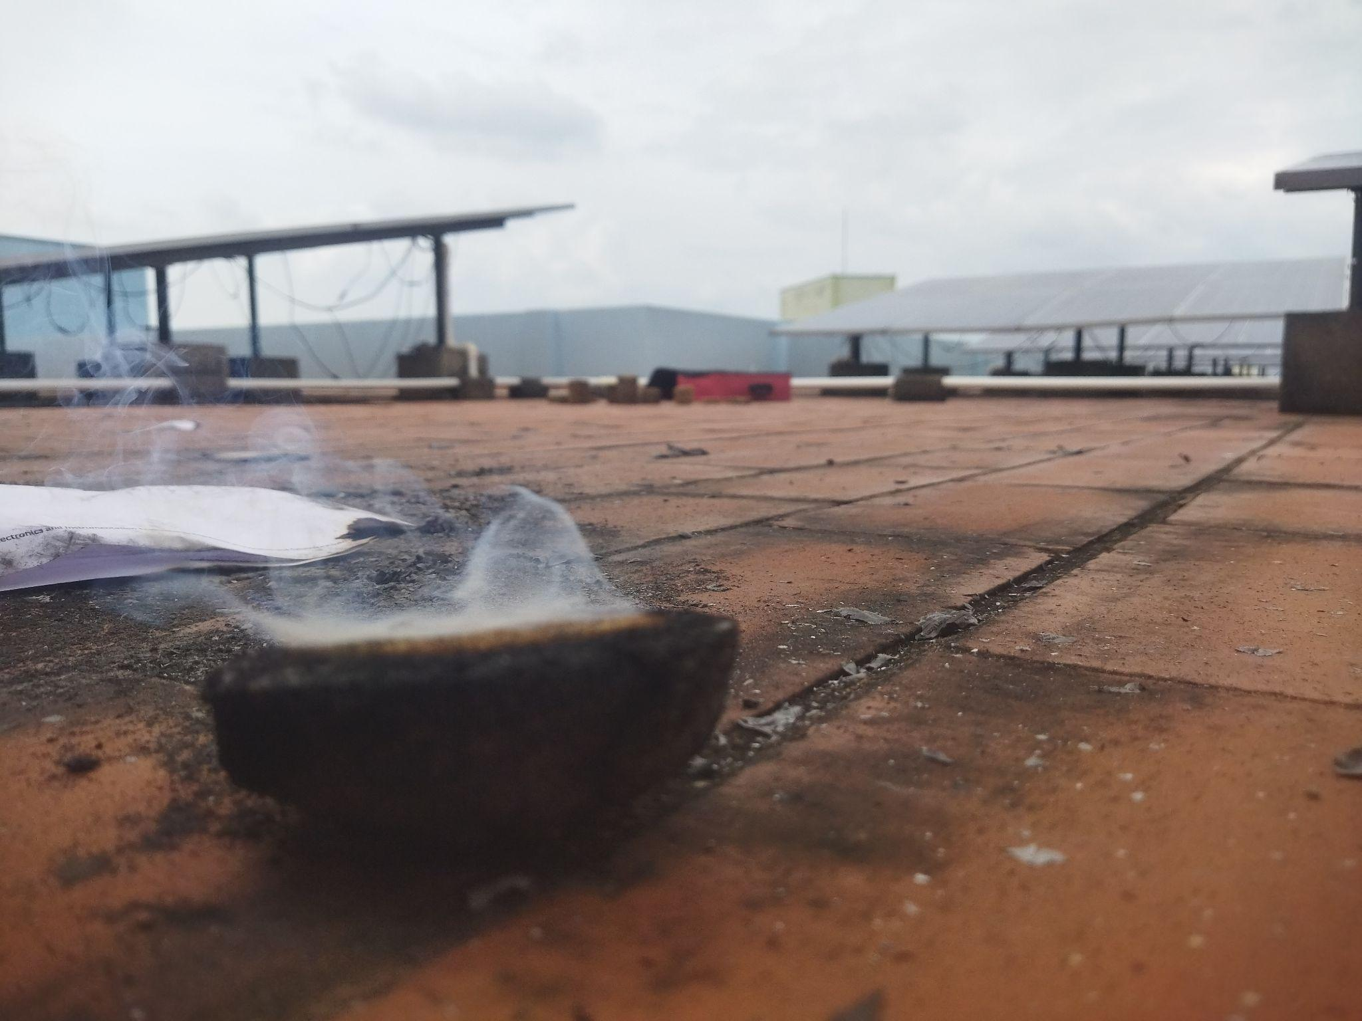
AgriHeatblocks

Slide 11
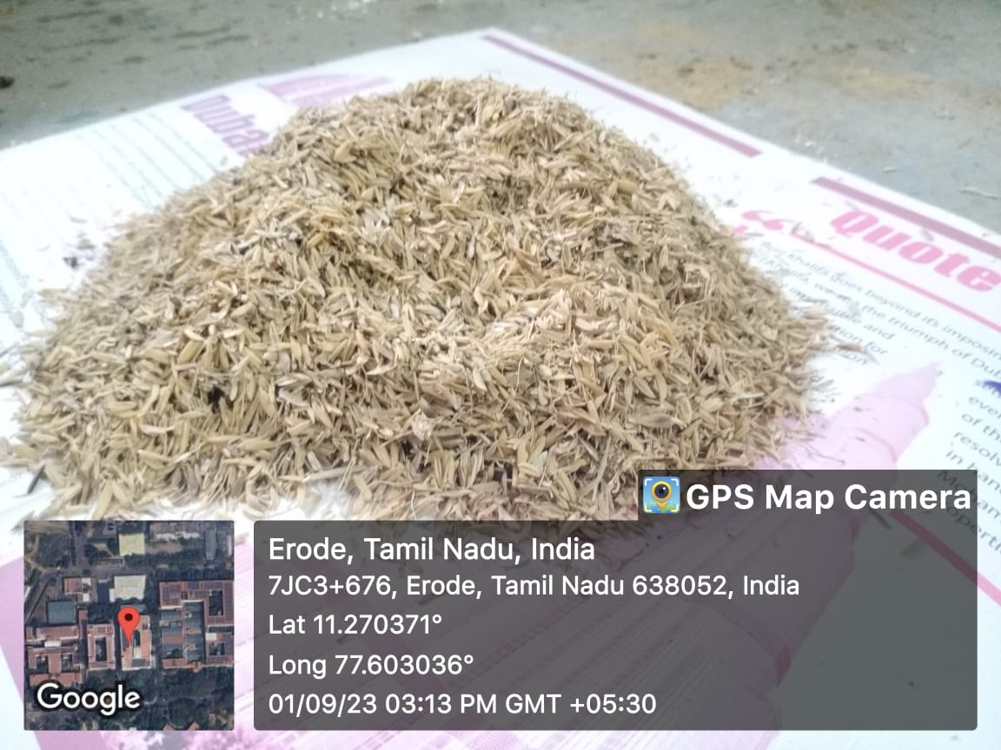
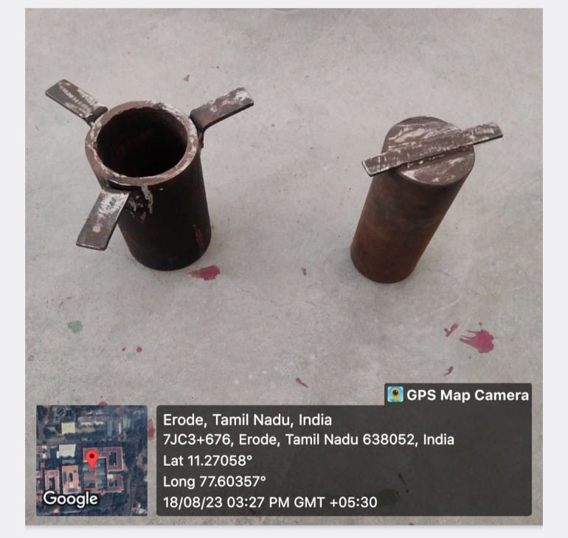
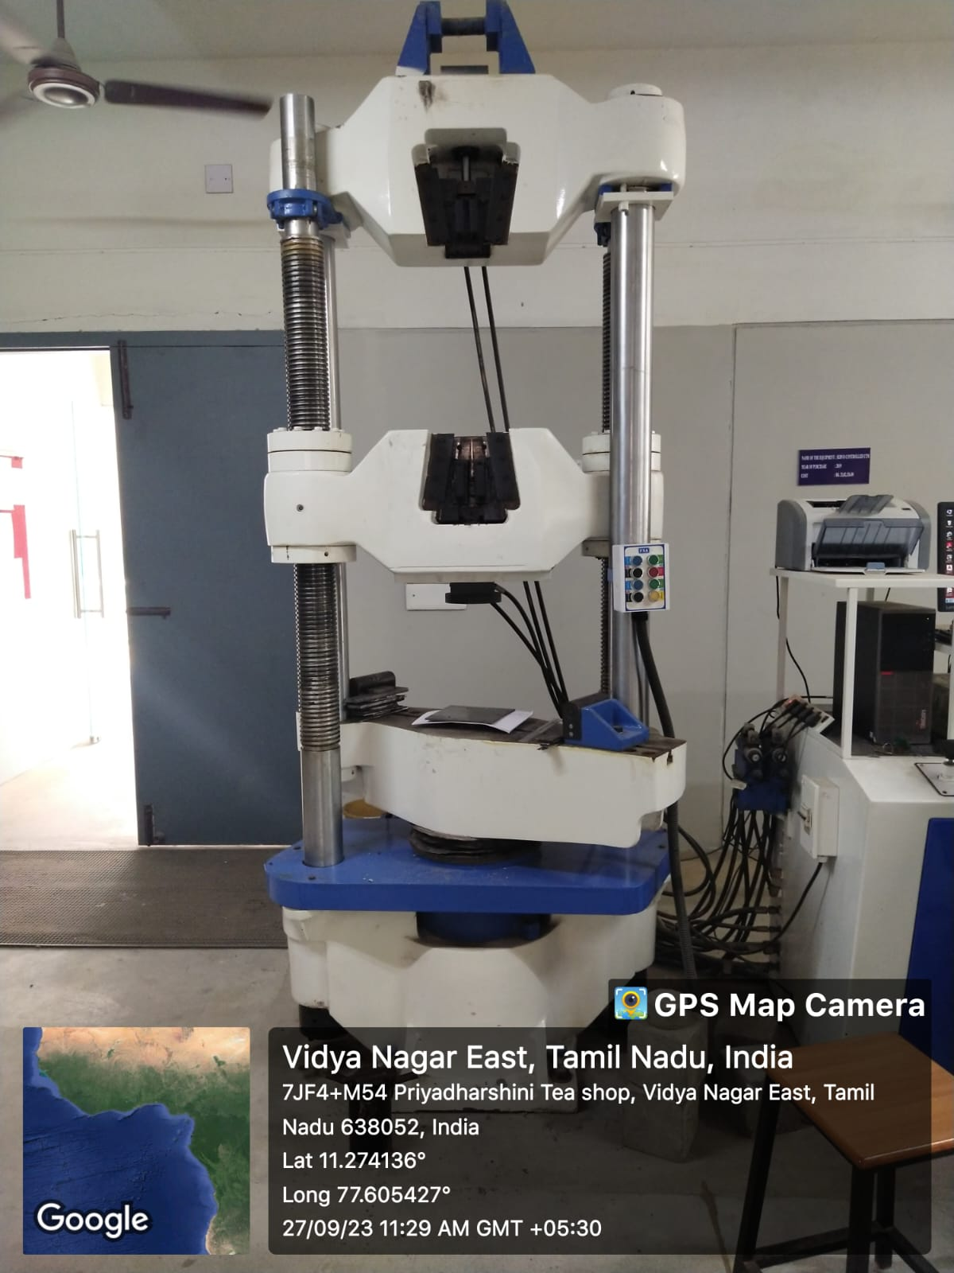
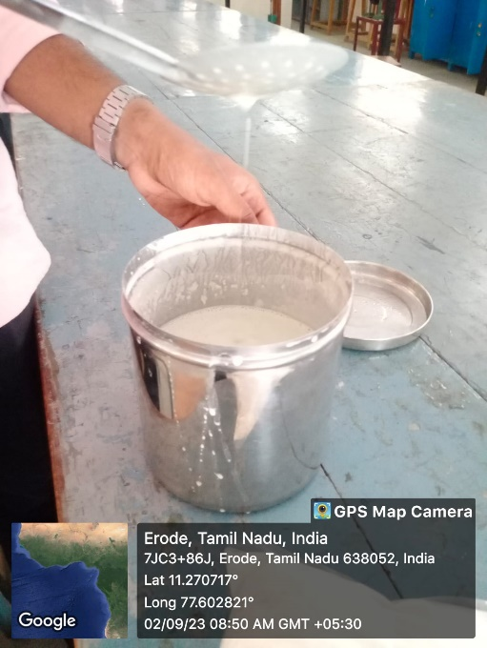
Technologies used
Grinded residues
BRIQUETTE MOULD
DIAMETER: 80mm
HEIGHT: 170mm
Hydraulic Press
Binder

Slide 12
Cost Analysis
Raw Materials Cost:
Crop | Total Residdue Produced (in MT) | Unused Residue (in MT) | Residue Purchase Cost(Rs/Kg)
Paddy Straw | 191.65 | 81.29 | 3.5
Paddy Husk | 16.35 | 10.32 | 2.5
Corn Cob | 75.69 | 41.72 | 3
Wheat Straw | 107.65 | 53.96 | 3

Slide 13
Cost Analysis
Manufacturing Cost:
Profitability:
Particulars | Rupees/ Tonne
Raw Materials | 3,770
Transportation | 200
Electricity | 150
Man Power | 120
Storage | 45
Total Manufacturing Cost | 4285
Total Cost of Raw Material/Ton
Rs. 3,770
Manufacturing Cost/ton
Rs. 515
Manufacturing Cost/ton
Rs. 515
Profit Per Tonne
Rs.3,125

Slide 14
Installation Cost
MACHINERIES | Cost/Unit | Power Consumption | Electricity Cost/Month in Rupees
Grinding Machine | 60,000 | 2Kwh | Rs.3750
Centrifeeder | 85,000 | 7Kwh | Rs.13120.5
Briquetting machine | 1,30,000 | 12Kwh | Rs.22500
Total | 3,95,000 | 21Kwh | Rs.39,370

Slide 15
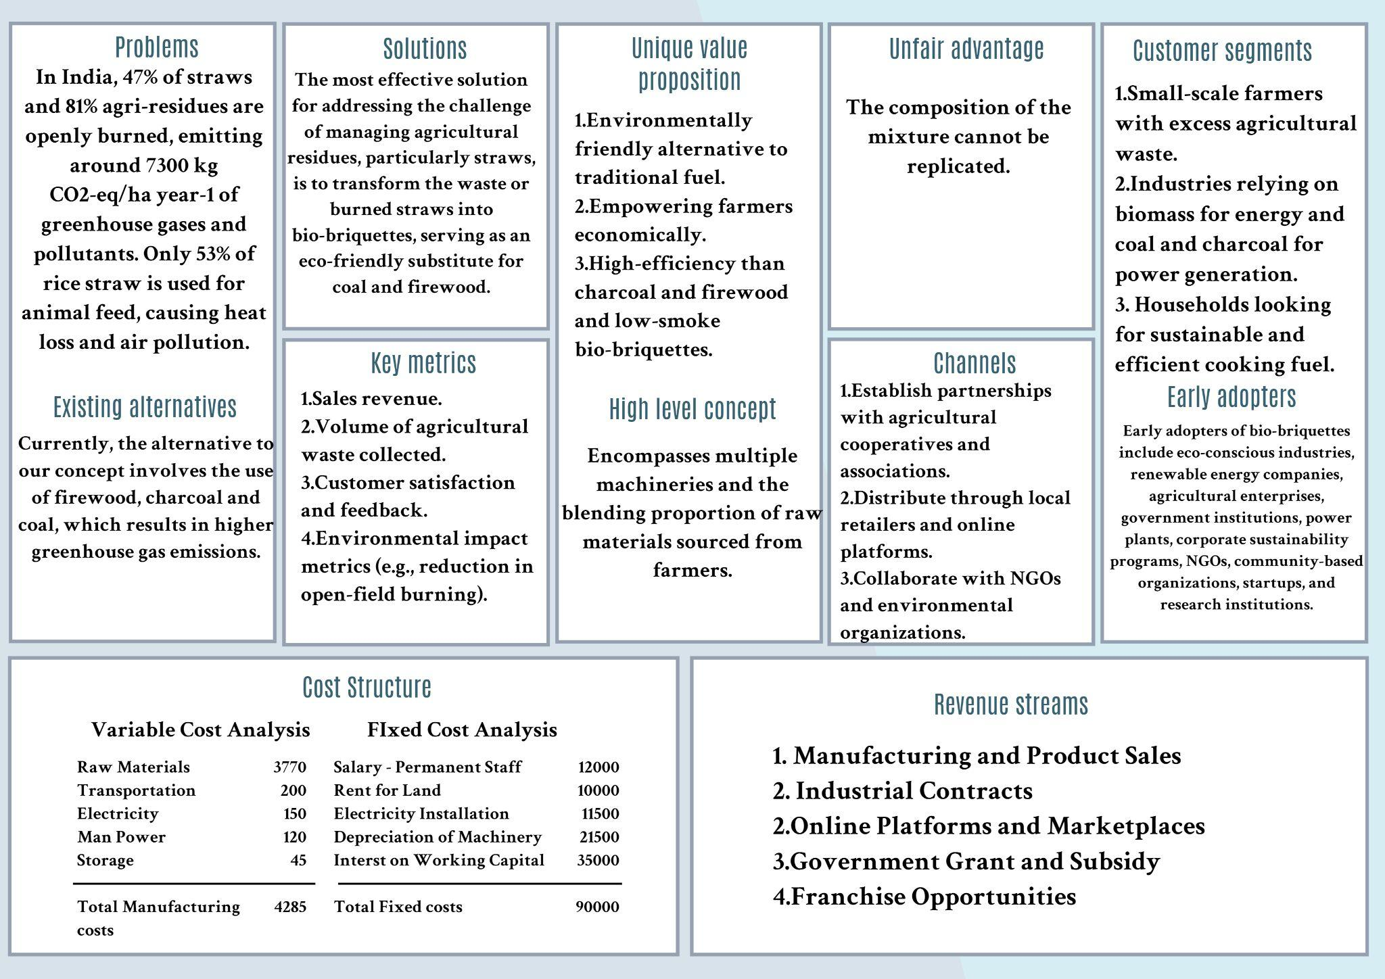
Canvas Model

Slide 16
Economical setup
In India, the total availability of paddy straw is about 126 million tons per annum. The total value of this straw is Rs 400 crore approx., calculated on an average rate of Rs 200/quintal. Almost all of it is burnt in fields
53% of this paddy crop's solid waste, 37% of wheat crop residues, Maize, the crop that is the third largest contributor to emissions, emitted 91 % (Table S4) of its total 2020 emissions due to the burning of Summer season residues is collected from the farmers for the cost/kg.
This accounts for economic loss apart from the loss of 77,000 tons of nitrogen and 5.6 million tons of Total Digestible Nutrients (TDN) which could be used for ruminant production
Hence, the economic condition and the environmental condition of the Nation will gain consistent growth through this, and the pollution among the major states will reduce in large amount

Slide 17
Prototype Performance report
• Maximum Temperature: 335.4°C
• Burning Time: 11.18 minutes
• Smoke Production: Less smoke compared to fuelwood
• Burning Rate: Slower burning rate than traditional fuelwood
• Calorific Value: Ranges from 15.2 to 17.5 MJ/Kg
FUEL TYPE | CALORIFIC VALUE | ° DEGREE IN CELSIUS | COST/KG
Coal & other fossil fuels | 25–35 MJ/kg. | 1000° | Rs.18-20
Fire Wood | 12.5-14.7MJ/kg | 300° | Rs. 16
Proposed Bio-Briquettes using agri residues | 15-17.8MJ/kg | 700° | Rs.9.5

Slide 18
Implementation videos
Burning of AgriHeatblock:
https://drive.google.com/file/d/1uY-E8r60lR3jbnSzPTDWeZ8VfhGAtVMg/view?usp=drivesdk
Burning with timer:
https://drive.google.com/file/d/1uvsqRu0aue2A-lVYMRFQw4AASA8pBeBc/view?usp=drivesdk
Interview with Stakeholder:
https://drive.google.com/file/d/1v8BHS1njnr07CslmYEC3j2qPRZlpIbcI/view?usp=drive_link
Github link:
https://github.com/sudhee30/Greenathon_AgriHeatblock/tree/main

Slide 19


